Slide 1
VEHICLE COMMUNICATION SYSTEM USING LORA FOR ENHANCED ROAD SAFETY

Slide 2
OBJECTIVE
Develop a LoRa-based vehicle communication system with gas, fire, and acceleration sensors.
Transmit real-time data between vehicles for improved road safety and driver awareness.
Leverage IoT for remote hazard detection and vehicle owner notification.

Slide 3
ABSTRACT
Road safety remains a critical concern. This project presents a novel LoRa (Long Range) technology-based vehicle communication system. The system features transmitter and receiver units. The transmitter integrates gas, fire, and acceleration sensors, along with a manual status button. Upon anomaly detection, data transmits via LoRa to the receiver. The receiver, equipped with an LCD and buzzer, alerts the driver. This system facilitates efficient communication of critical surroundings information, promoting accident prevention and overall road safety.

Slide 4
INTRODUCTION
Advanced automotive technologies have significantly improved safety standards. This project proposes a LoRa-based vehicle communication system. LoRa's long-range and low-power features enable real-time data transmission between vehicles, overcoming limitations of traditional methods.

Slide 5
PROBLEM STATEMENT
Current vehicle communication systems lack real-time data exchange capabilities and often rely on short-range technologies. This hinders driver awareness of surrounding hazards, potentially leading to accidents.

Slide 6
LITERATURE SURVEY

Slide 7
SI.NO | TITLE OF THE PROJECT | AUTHOR | DRAWBACKS
1. | Feature-Based Vehicle Identification Framework for Optimization of Collective Perception Messages in Vehicular Networks | HIDETAKA MASUDA, OUSSAMA EL MARAI , MANABU TSUKADA, TARIK TALEB AND HIROSHI ESAKI | Limited range
2. | Computationally Efficient Nonlinear One- and Two-Track Models for Multi trailer Road Vehicles | TOHEED GHANDRIZ, BENGT JACOBSON, PETER NILSSON, LEO LAINE AND NIKLAS FRÖJD | Scalability and Compatibility
3. | An Improved Motion Control With Cyber-Physical Uncertainty Tolerance for Distributed Drive Electric Vehicle | WANKE CAO , ZHIWEN ZHU, JINRUI NAN | Power Consumption

Slide 8
EXISTING SYSTEM
Advanced driver-assistance systems (ADAS) primarily focus on in-vehicle safety features.
ine-of-sight methods (e.g., thermal cameras)

Slide 9
DISADVANTAGES
Limited range of communication
Inability to convey specific hazard information
Focus on in-vehicle safety rather than driver awareness of external threats contact with the subject

Slide 10
PROPOSED SYSTEM
The proposed system employs LoRa technology for real-time data exchange between vehicles. It comprises interconnected transmitter and receiver modules.

Slide 11
ADVANTAGES
Long range communication between vecihels
Real-time data transmission of gas, fire, and acceleration anomalies
Manual status indication button for immediate hazard reporting
Improved driver awareness of surrounding hazards
Potential for accident prevention and enhanced road safetycident prevention and enhanced road safety

Slide 12
TECHNOLOGIES USED IN PROPOSED SYSTEM
LoRa Low-power, long-range wireless communication technology
Sensors Gas, fire, and acceleration sensors for hazard detection
Microcontroller Processes sensor data and facilitates LoRa communication
LCD Display (Receiver) Visually displays received data
Buzzer (Receiver) Provides audible alerts for detected anomalies

Slide 13
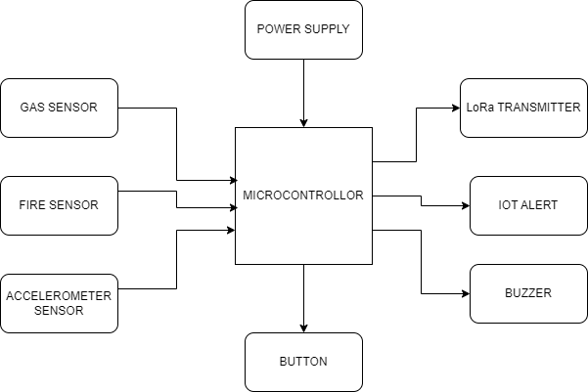
BLOCK DIAGRAM FOR HARDWARE TRANSMITER PART

Slide 14
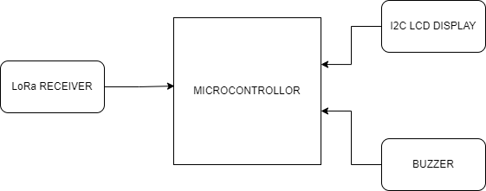
RECIVER PART

Slide 15
BLOCK DIAGRAM EXPLANATION
The block diagram for the proposed vehicle communication system consists of two main sections: the transmitter and the receiver. The transmitter section includes gas, fire, and accelerometer sensors, along with a manual status indication button. Data from these sensors is processed by a microcontroller and transmitted via a LoRa transmitter.
The receiver section comprises a LoRa receiver, which receives the transmitted data and forwards it to another microcontroller. An LCD display and a buzzer are connected to the receiver microcontroller to provide real-time alerts to the vehicle owner. This modular setup ensures efficient data transmission and immediate response to detected anomalies, enhancing overall road safety.

Slide 16
HARDWARE REQUIRED
Microcontroller
Gas sensor
Fire sensor
Accelerometer sensor
LoRa Transmitter
LoRa Receiver
I2C LCD
Button
Buzzer

Slide 17
SOFTWARE REQUIRED
Arduino ide
Embedded C

Slide 18
HARDWARE MODULE

Slide 19
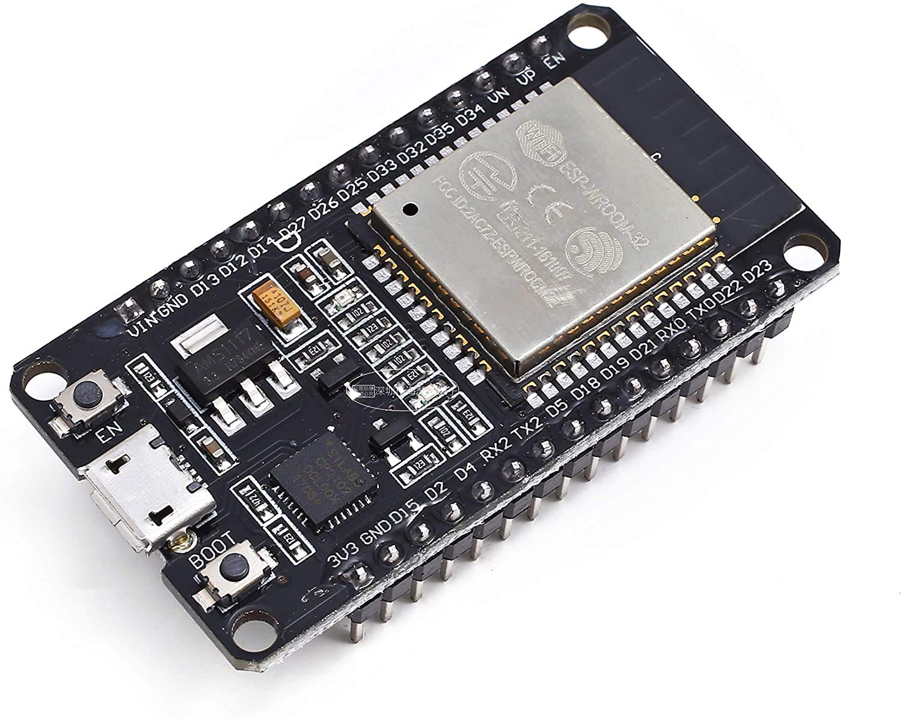
NODEMCU(ESP32)
The ESP32 is a versatile microcontroller chip developed by Espressif Systems, widely recognized for its high-performance computing capabilities, integrated Wi-Fi and Bluetooth connectivity, and low power consumption. With a dual-core processor, ample memory, and a rich set of peripherals, the ESP32 is commonly used in IoT projects, home automation, and wearable devices due to its versatility, affordability, and ease of programming.

Slide 20
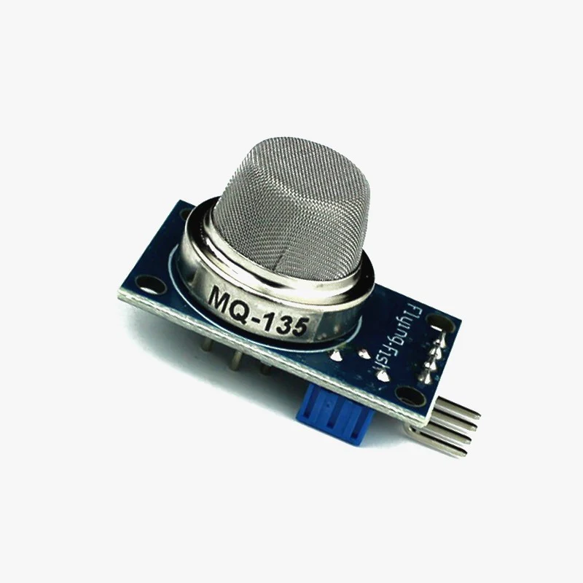
GAS SENSOR
A gas sensor is a device that detects the presence or concentration of gases in the surrounding environment. It typically operates by measuring changes in electrical conductivity, optical absorption, or chemical reactions caused by the target gas molecules. Gas sensors are widely used in various applications such as air quality monitoring, industrial safety, and combustion control, providing crucial information for ensuring safety and environmental health.

Slide 21
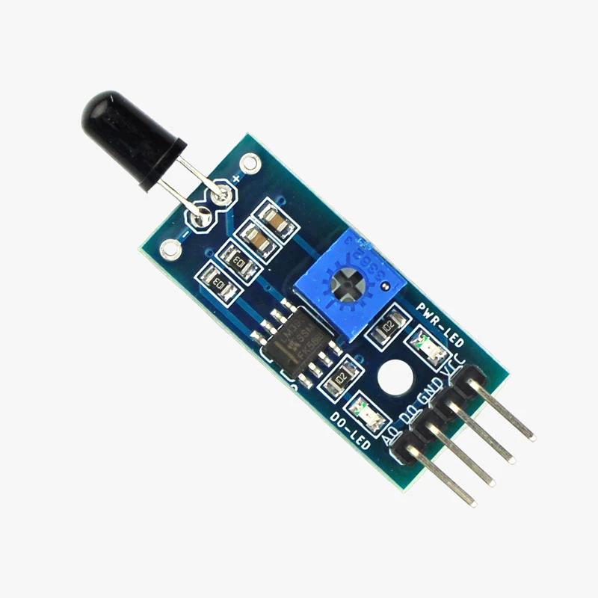
FIRE SENSOR
A fire sensor, also known as a smoke detector, is a device that senses smoke or combustion products in the air. It typically operates using either optical or ionization methods to detect the presence of smoke particles. When smoke is detected, the sensor triggers an alarm, alerting occupants of potential fire hazards and allowing for timely evacuation and intervention. Fire sensors are essential components of fire detection and alarm systems, playing a critical role in protecting lives and property from the dangers of fire.

Slide 22
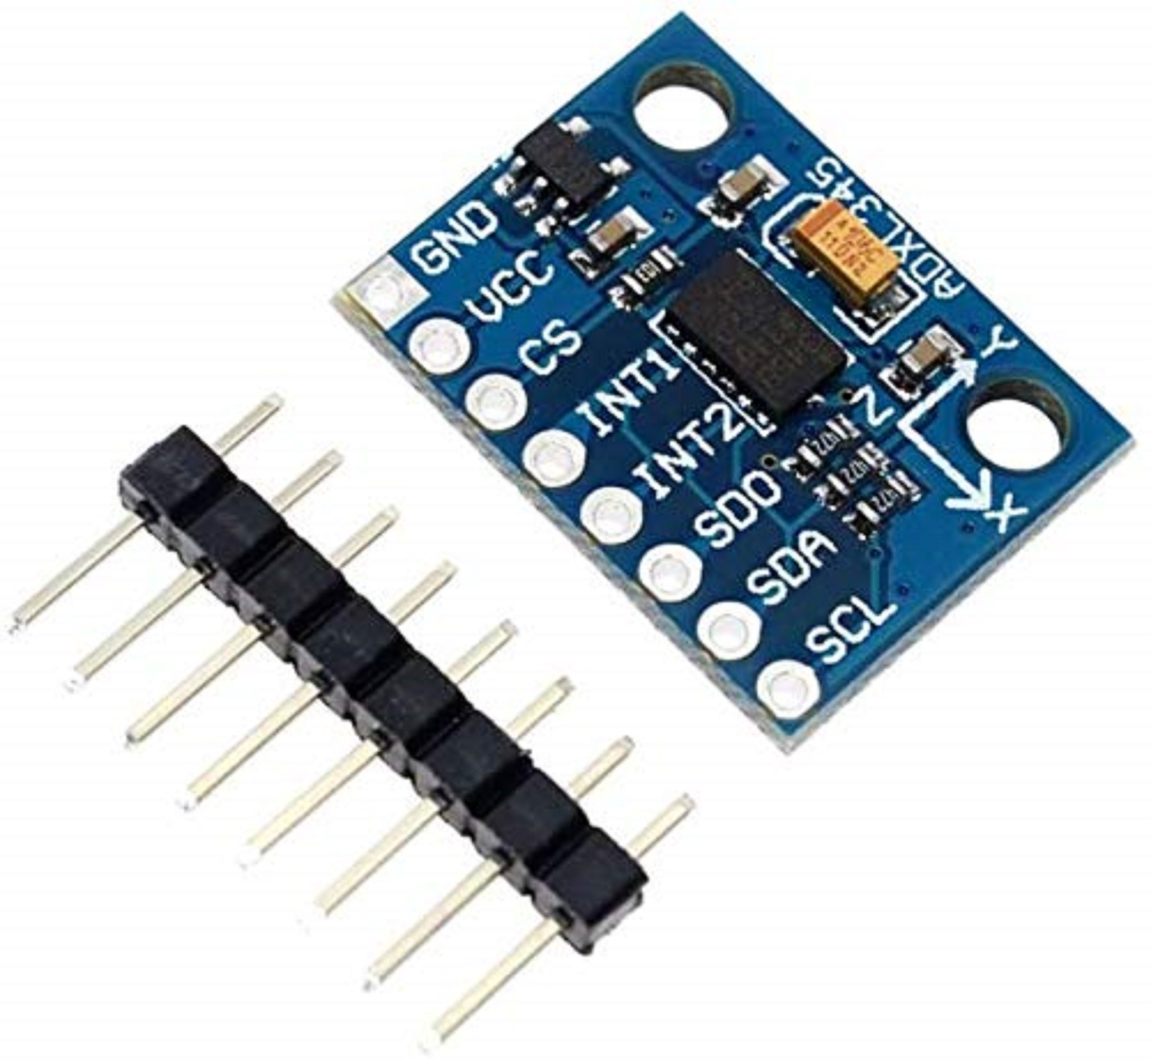
ACCELEROMETER SENSOR
An acceleration sensor, commonly known as an accelerometer, measures the rate of change of velocity of an object along one or more axes. It detects acceleration forces, including gravity, and converts them into electrical signals. Accelerometers are widely used in various applications such as automotive safety systems, motion detection in electronic devices, and inertial navigation systems. They provide crucial data for monitoring and controlling motion, orientation, and vibration in both consumer and industrial applications.

Slide 23
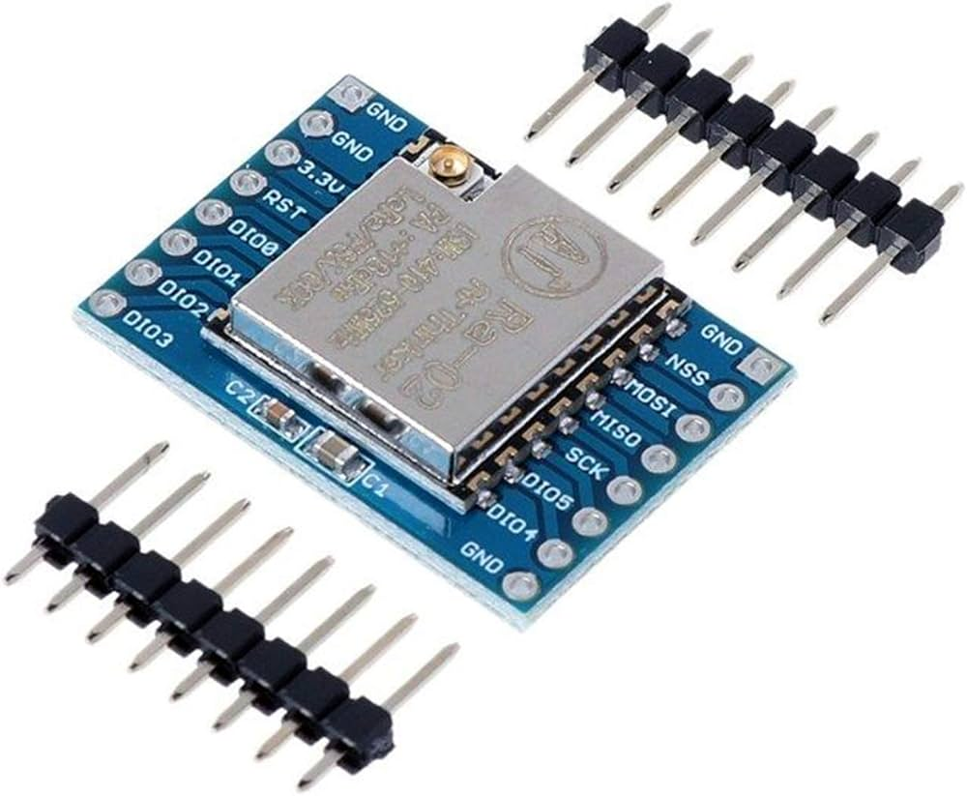
LORA MODULE
A LoRa (Long Range) module is a wireless communication device that utilizes the LoRa modulation technique to enable long-range transmission of data with low power consumption. It operates in unlicensed frequency bands, typically in the sub-gigahertz range, and offers extended communication ranges of several kilometers in urban and rural environments. LoRa modules are commonly used in IoT applications, smart city infrastructure, and remote monitoring systems for transmitting sensor data over long distances with minimal energy consumption.

Slide 24
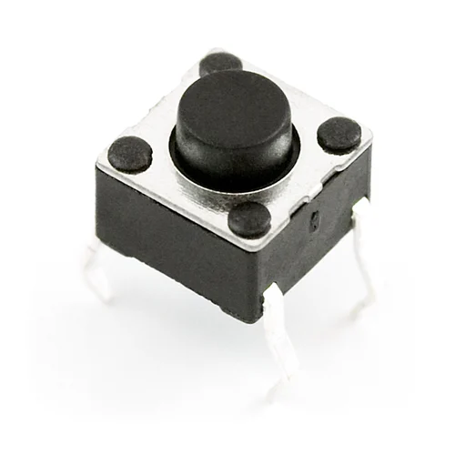
PUSH BUTTON
A push button is a simple mechanical switch that is manually pressed to make or break an electrical connection. When pressed, it completes a circuit, allowing current to flow through the connected circuitry. Push buttons are widely used in electronic devices, control panels, and user interfaces for initiating actions, toggling functions, or activating/deactivating devices with a simple push motion.

Slide 25
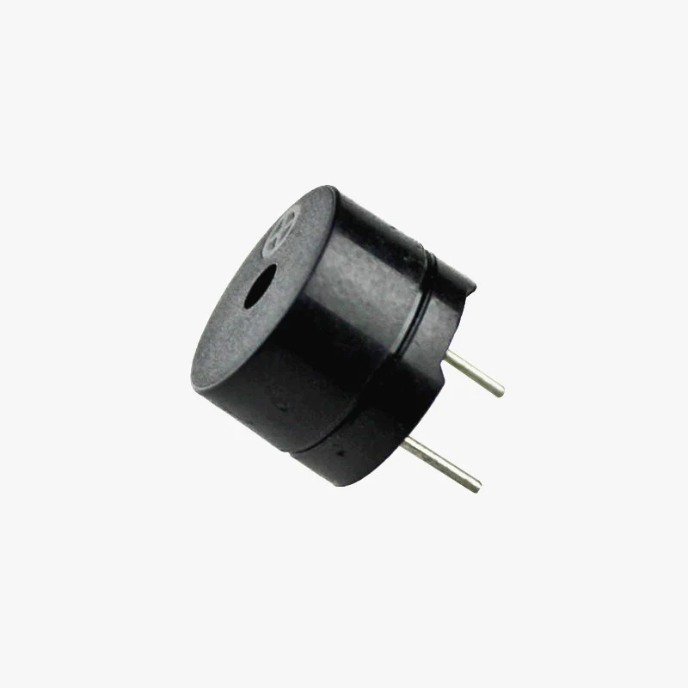
BUZZER
A buzzer is an electro-acoustic device that generates sound when an electrical current passes through it. It typically consists of a vibrating element, such as a piezoelectric disk or a magnetic coil, and a resonant cavity that amplifies the sound produced. Buzzer devices are commonly used in alarm systems, electronic games, and notification systems to provide audible alerts or signals to users.

Slide 26
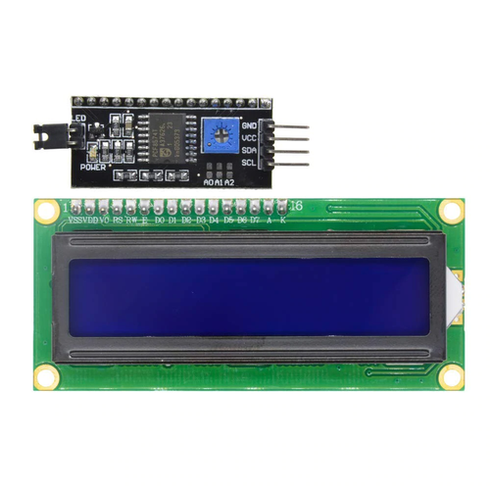
I2C LCD
The I2C LCD (Inter-Integrated Circuit Liquid Crystal Display) is a type of LCD display that uses the I2C protocol for communication with a microcontroller or other devices. It simplifies wiring by requiring only two data lines (SDA and SCL) for communication. With its compact design and ease of integration, the I2C LCD is commonly used in embedded systems, IoT devices, and robotics for displaying information such as sensor readings, status messages, and user interfaces.

Slide 27

ARDUINO IDE
The Arduino Integrated Development Environment - or Arduino Software (IDE) - contains a text editor for writing code, a message area, a text console, a toolbar with buttons for common functions and a series of menus. It connects to the Arduino and Genuino hardware to upload programs and communicate with them.

Slide 28
CONCLUSION
The proposed LoRa-based vehicle communication system offers a promising solution for improved road safety. Real-time data exchange and hazard awareness empower drivers to react effectively to potential threats, contributing to a safer driving environment.

Slide 29
FUTURE SCOPE
Integration with existing ADAS systems for a comprehensive safety approach
Development of a mobile application for remote vehicle monitoring and alerts
Exploration of incorporating additional sensors for more comprehensive hazard detection
Investigation of mesh networking capabilities for broader communication range

Slide 30
REFERENCE
S. Iranmanesh, F. S. Abkenar, A. Jamalipour, and R. Raad, “A heuristic distributed scheme to detect falsification of mobility patterns in internet Of vehicles,” IEEE Internet Things J., vol. 9, no. 1, pp. 719–727, Jan. 2022.
O. E. Marai and T. Taleb, “Smooth and low latency video streaming for autonomous cars during handover,” IEEE Netw., vol. 34, no. 6, pp. 302–309,Nov./Dec. 2020.
T. Taleb, A. Ksentini, and F. Filali, “Wireless connection steering for vehicles,” in Proc. IEEE Glob. Commun. Conf., 2012, pp. 56–60.
T. Taleb, A. Benslimane, and K. B. Letaief, “Toward an effective risk conscious and collaborative vehicular collision avoidance system,” IEEE Trans. Veh. Technol., vol. 59, no. 3, pp. 1474–1486, Mar. 2010.

